Slide 1




The Consutant! Website
Prepared By:
Sarah AlJurbua
Fatemah AlGarni
Fayza AlRasheed
Munira AlSaleh
Reema AlMazyad
Section 1180

Slide 2

OUTLINE
Introduction
Overall Description
Requirements and Attributes
Diagrams and Tables
References and Resources
High-fidelity Prototype

Slide 3
01
Introduction
Project Purpose:
The scope of “The Consultant Website” high-fidelity prototype is to develop a user-friendly platform that enables clients to easily browse and book online meetings with lawyers from various law firms.
SRS Overview:
Document Convention
References
Functionalities offered in the high-fidelity prototype
User Requirements
Different diagrams and tables
Elicitation of requirements using interviews and google form surveys
Slogan: “Instant Legal Meetings with Top Lawyers: Anytime, Anywhere”

Slide 4
02
Overall Description
The Project Functions:
Our website is expected to perform the following
System shall allow the user to create an account.
System shall allow the user to let the client see who’s lawyer available.
System shall allow the user to choose the payment option.
User Classes and Characteristics:
Lawyer: A lawyer is a person who advises and represents clients.
Client: A client is a person who uses The consultant Website to take advice from lawyers.
The consultant website: A website that enables clients to browse and book online meetings.
Admin: The admin is responsible for managing the system.
Assumptions and Dependencies:
The consultant website is operating 24 hours a day 7 days a week.
Whenever the client books an available appointment and the lawyer accepts, the client can pay, and the lawyer will update his schedule according.
The meeting platform between the lawyer and the client is compatible with the Saudi bar association environment.

Slide 5
03
Requirements
Software Interface Requirements:
Payment interface
Post and prepayment communications interface
Consultant Database System
Non-functional Requirements:
Performance Requirements
Safety Requirements
Security Requirements
Attributes:
Usability
Performance
Security
Safety

Slide 6
Use Case ID: | 1
Use Case Name: | Create an account
Actors: | User
Description | The user can sign in to the Consultant website. They ought to be able to register, log in if they already have an account, and continue browsing as a guest.
Preconditions: | The user should have access to the internet.
Postconditions: | The user’s username and password are saved in the system.
Normal Flow: | 1. The registration page is shown on the system. 2. User requests to register. 3. The system shows the sign-up page. 4. The user inputs their ID, name, email, and phone number. 5. The user is prompted to input their new username and password by the system. 6. The system makes sure the username is available. 7. The user is prompted to enter their password again. 8. The system verifies that the signup was successful. 9. Home page is shown by the system.
Alternative Flows: | 1.1. User already has an account: 1. The user chooses to log in. 2. System displays a login page. 3. User enters an email address and password. 4. System verifies email address and password. 5. The system checks if the user has two operators Enable authentication on the user account If so, the second authentication will be required. 6. System notifies user login was successful. 7. System displays the home page.
Exceptions: | 1.0.E.1: Username or password incorrect 1. The system finds the username or password incorrect. 2. System notifies the user that the login was not successful. 3. System returns to the login page (step 2). 1.0.E.2: Email address is taken (branch after step 5) 1. The system notifies the user that the email address is taken. 2. System goes to the login page (step 2 in 1.1).

Slide 7
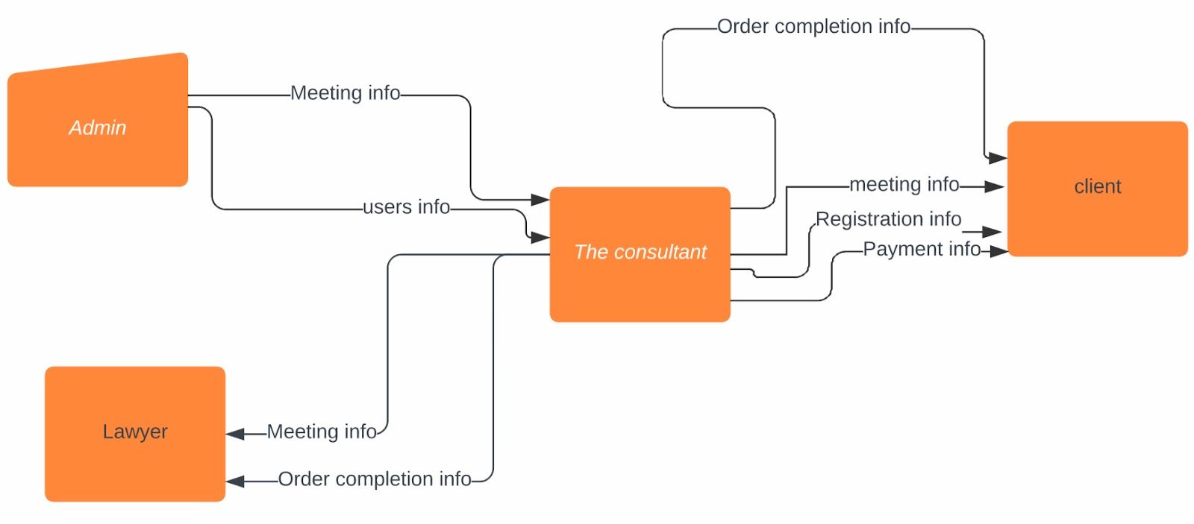
04
Diagrams and Tables

Slide 8
05
References and Resources
Functional and Nonfunctional Requirements: Specification and Types. (2021, July 23). AltexSoft. /https://www.altexsoft.com/blog/business/functional-and-non-functio nal-requirements-specification-and-types
Krüger, G. (2023b). How to Write a Software Requirements Specification (SRS Document). Perforce Software. https://www.perforce.com/blog/alm/how-write-software-requirement s-specification-srs-document
WordPress.com. (n.d.-b). WordPress.com. https://wordpress.com/home/sarahaljurbua.wordpress.com
The Consultant! (n.d.). The Consultant! https://sarahaljurbua.wordpress.com/
Lucid. (n.d.). Intelligent Diagramming | Lucidchart. Lucidchart. https://www.lucidchart.com/pages/

Slide 9
06
High-fidelity Prototype
https://sarahaljurbua.wordpress.com/

